Slide 1
Digital Portfolio
STUDENT NAME: HISAANATH R
REGISTER NO AND NMID: astvu35235224u18010
DEPARTMENT: B.SC COMPUTER SCIENCE
COLLEGE: COLLEGE/ UNIVERSITY: HOLY CROSS ARTS AND SCIENCE COLLEGE FOR WOMEN / THIRUVALLUVAR UNIVERSITY

Slide 2
PROJECT TITLE
DIGITAL PORTFOLIO

Slide 3


AGENDA
Problem Statement
Project Overview
End Users
Tools and Technologies
Portfolio design and Layout
Features and Functionality
Results and Screenshots
Conclusion
Github Link
3/21/2024 Annual Review

Slide 4

PROBLEM STATEMENT
In today’s competitive academic and professional world, traditional resumes and paper-based portfolios are not enough to represent one’s skills, creativity, and achievements. There is a need for a dynamic, accessible, and visually appealing platform that showcases a person’s work effectively to potential employers, educators, and collaborators.

Slide 5

PROJECT OVERVIEW
The digital portfolio is an interactive platform that highlights personal, academic, and professional achievements. It serves as a centralized hub to present skills, projects, certifications, and experiences in a creative and organized manner. The portfolio also enhances online presence and helps individuals stand out in their respective fields.

Slide 6

WHO ARE THE END USERS?
Students (for academic presentations, internships, and higher studies applications)
Job Seekers (to present skills and projects to recruiters)
Freelancers (to showcase their work to clients)
Professionals (to build an online identity and career growth)
Educators/Researchers (to share publications, achievements, and teaching experiences)

Slide 7

TOOLS AND TECHNIQUES
Design Tools: Canva, Figma, Adobe XD
Development Tools: HTML, CSS, JavaScript, React
Portfolio Platforms: WordPress, Wix, Behance, GitHub Pages
Supporting Tools: MS PowerPoint, Google Sites, Notion for structuring content

Slide 8
POTFOLIO DESIGN AND LAYOUT
Home Page: Introduction, personal branding (name, tagline, photo)
About Me: Educational background, career goals
Skills Section: Technical, creative, and soft skills
Projects Section: Detailed case studies with visuals
Resume/Download Option: Digital CV access
Contact Page: Email, LinkedIn, social media links
8

Slide 9
FEATURES AND FUNCTIONALITY
Interactive navigation (menu bar, quick links)
Responsive design (works on all devices)
Downloadable resume option
Embedded project samples (images, documents, or videos)
Contact form with email integration
Customization (theme, colors, fonts)
Analytics (optional): To track visitors and engagement

Slide 10

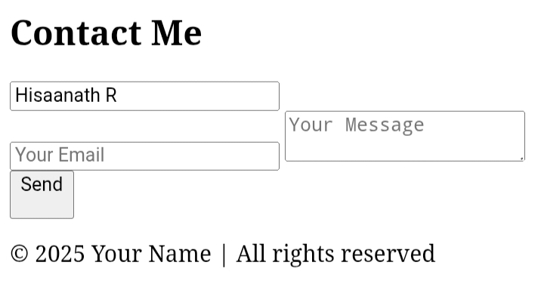
RESULTS AND SCREENSHOTS
1. Developed a professional digital portfolio to present skills, projects, and achievements effectively.
2. Increased career opportunities and personal branding through an engaging online presence.
3/21/2024 Annual Review
10

Slide 11
CONCLUSION
The digital portfolio serves as a powerful tool for self-presentation in the modern academic and professional world. By integrating design, functionality, and accessibility, it not only highlights individual strengths but also provides a competitive edge. It ensures that the user’s work is showcased dynamically, leaving a lasting impression on potential employers and collaborators.
11

